Slide 1
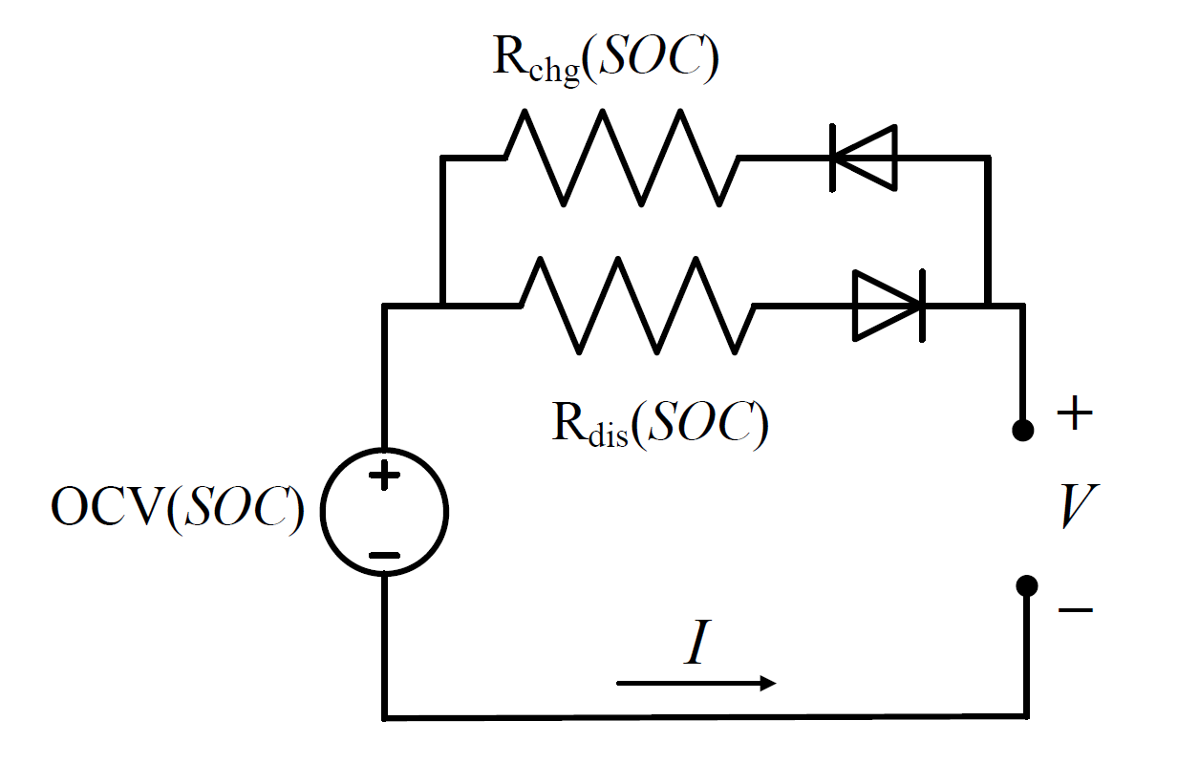
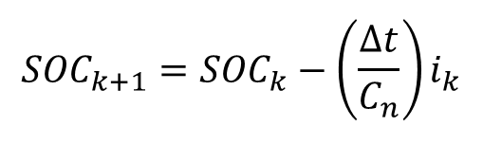

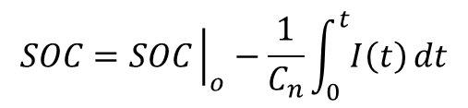
SIMPLE MODEL (OCV-R)
OCV-R Battery Model
$$V_{k}=OCV\left({SOC}_{k}\right)−i_{k}∗R$$
$$V_{T}=OCV\left(SOC\right)−I ∗R\left(T, SOC\right)$$
$$SOC=SOC{\left.​\right|}_{o}−\frac{1}{C_{n}}\int_{0}^{t}{I\left(t\right)}dt$$
$${SOC}_{k+1}={SOC}_{k}−\left(\frac{∆t}{C_{n}}\right)i_{k}$$
Notes:
- The simple battery model is as shown in the figure, the voltage source represents the OCV which is function of the battery state of charge. Then, the battery charging and discharging internal resistance are reprensted as RChg and Rdis. By subtracting the voltage drop across the resistance from the battery OCV, you can calculate the battery terminal voltage V.
The battery internal resistance is function of the battery temperature, SOC and life.
- In the following section, we are going to simulate the simple battery model using MATLAB and Simulink.

